Slide 1
Health risk estimate for groundwater and soil contamination in the Slovak Republic – a convenient tool for identification of risk areas
¹Fajčíková K., ¹Cvečková V., ¹Rapant S.
¹State Geological Institute of D. Štúr, Mlynská dolina 1, 817 04 Bratislava, Slovak Republic katarina.fajcikova@geology.sk

Slide 2
Origin of this research
has gone with new idea to find mechanism for map visualization of quantitative assessment of health risks from contamination of geological environment in the Slovak Republic
by
combining international principles and methodology of health risk assessment with methodological procedures used in environmental geochemistry
that would be
easy to understand and usefull in decision make process

Slide 3
Objective of the work was based on this idea and includes:
Quantitative estimation of health risk to residents living in the Slovak Republic of exposure to contaminated groundwater (adult population) and soils (adult and child population)
Identification of potential risk areas within the country based on map visualization.

Slide 4
Background of the work
Identification and characterization of:
distribution of chemicals in groundwater and soils,
contamination of geological environment and sources of contamination,
Within environmental-geochemical mapping programme in the Slovak Republic at:
national level – Geochemical Atlases of the Slovak Republic at the scale 1:1 000 000,
regional level – environmental-geochemical maps of selected regions at the scale 1:50 000.

Slide 5
Background of the work
Sources of groundwater and soil contamination in the Slovak Republic:
Main geogenic (natural) sources
specific rock types and associated mineralization occurrences and ore deposits
(e.g. hydrothermal vein mineralization associated with granitoids and metamorphic rocks, low-sulphide mineralization associated with Neogene volcanics, Paleozoic sediment-hosted mineralizations)
Increased groundwater and soil contents of potentially toxic elements: As, Pb, Zn, Cu, Hg, Sb
Main anthropogenic sources
Mining activities, Metallurgy, Agriculture, Waste industry, Other industrial activities (chemical industry, refineries etc.), Transport etc.
Increased groundwater and soil contents of various chemical elements / components: As, Cd, Hg, Pb, Ni, Fe, Mn, Al, Zn, Cu, Cr, NO₃⁻, SO₄²⁻, NH₄⁺ etc.
Geogenic-anthropogenic sources (e.g. historical mining areas)

Slide 6
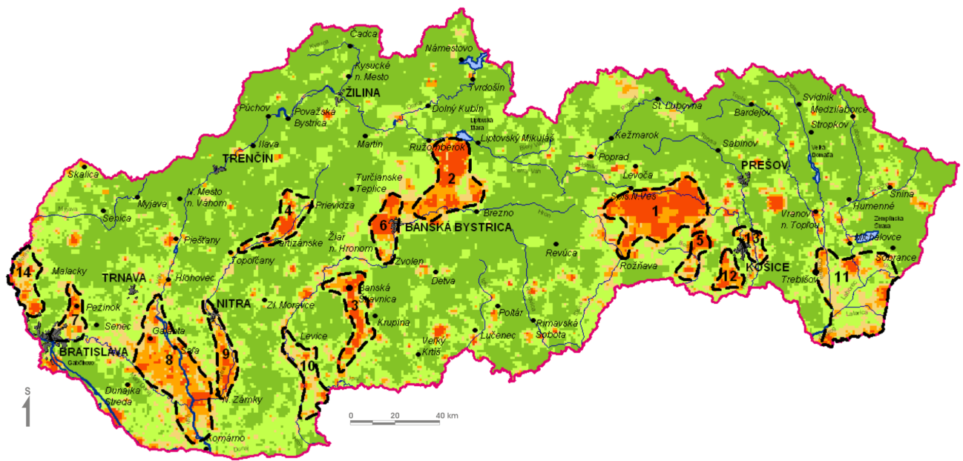
Background of the work
Output: Environmental – geochemical regionalization of the Slovak Republic (Rapant et al. 2004)

Slide 7
Background of the work
Data source for health risk estimate for groundwater and soil contamination in the Slovak Republic
Datasets of 20 339 groundwater samples and 10 738 soil samples were transformed in mean values of respective chemical elements and components for single administrative units of the Slovak Republic (municipalities, districts, regions) based on grid data interpolation
- calculation of arithmetic means for grid cells falling into bounds of every single administrative unit

Slide 8
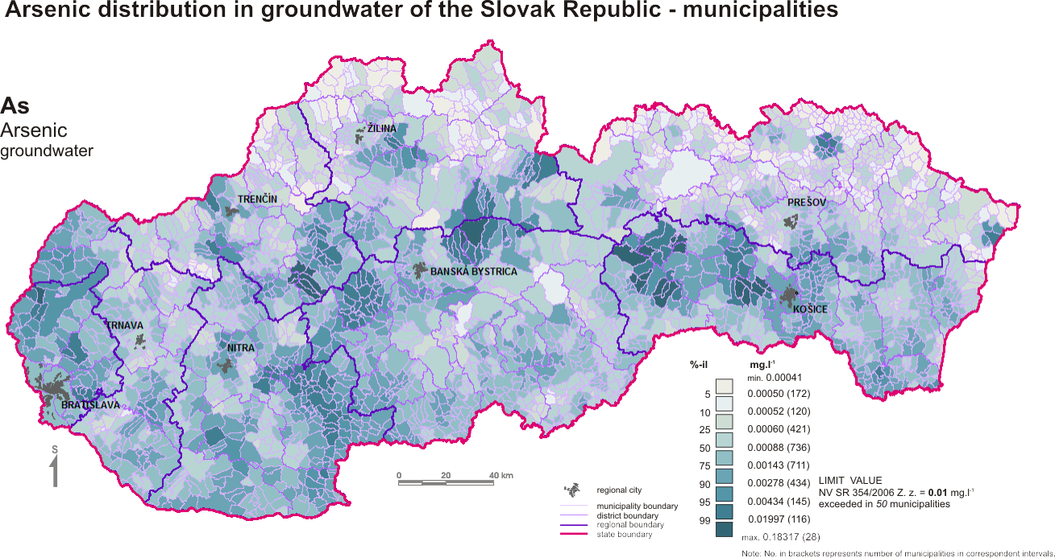
Background of the work
Example for surface distribution of arsenic in groundwater in municipalities of the Slovak Republic

Slide 9
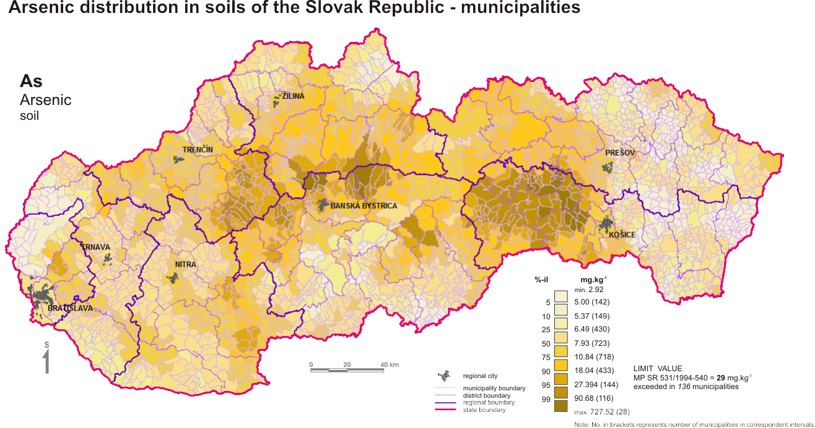
Background of the work
Example for surface distribution of arsenic in soils in municipalities of the Slovak Republic

Slide 10
Health risk estimate – US EPA methodology
Data evaluation
Mean values for Slovak municipalities for following contaminants with defined toxicity data were included in calculation of health risk estimates:
Groundwater – As, Ba, Cd, Cu, F, Hg, Mn, NO3, Pb, Sb, Se, Zn
Soils - As, B, Ba, Be, Cd, Cu, F, Hg, Mn, Mo, Ni, Pb, Sb, Se, Zn
Exposure assessment
Toxicity assessment (IRIS database)
Groundwater and soil contents (C) – specific value,
Other exposure data – model values for (US EPA)
Exposure route - ingestion
Chronic effects: principle of REFERENCE DOSE (RfD) was applied („existence of „safe“ dose)
Carcinogenic effects: principle of cancer slope factor (CSF) was applied
(„no dose is safe“)
Risk characterization
RISC Workbench – software used for calculations
CHRONIC RISK
CANCER RISK

Slide 11
Health risk estimate
Input exposure parameters were following:
for adult population
Analyzed media | Parameter |  | Value | Unit | Reference
 | BW | Body weight | 70 | kg | US EPA, 1991
 | AT* | Averaged exposure period
 |  | - cancer risk | 25 550 | day | US EPA, 1989a
Groundwater | AT* | Averaged exposure period
 |  | - chronic risk | 25 550 | day | US EPA, 1989a
 | CW | Groundwater concentration of chemical | Specific locally | mg l⁻¹
 | IR | Daily water intake | 2 | l day⁻¹ | US EPA, 1989b
 | EF | Exposure frequency | 365 | day year⁻¹ | US EPA, 1989a
 | ED | Exposure duration | 70 | year | US EPA, 1989a
Soils | AT* | Averaged exposure period
 |  | - chronic risk | 23360 | day | US EPA, 1989a
 | CS | Soil concentration of chemical | Specific locally | mg kg⁻¹
 | IR | Daily soil intake | 50 | mg day⁻¹ | US EPA, 1991
 | FI | Fraction ingested from contaminated source | 1 | - | US EPA, 1991
 | EF | Exposure frequency | 40 | day year⁻¹ | US EPA, 1999b
 | ED | Exposure duration | 64 | year | US EPA, 1991
 | CF | Conversion factor | 10⁻⁶ | kg mg⁻¹ | US EPA, 1989a

Slide 12
Health risk estimate
Input exposure parameters were following:
for child population
Analyzed media | Parameter |  | Value | Unit | Reference
 | BW | Body weight | 15 | kg | US EPA, 1991
 | AT* | Averaged exposure period
 |  | - Chronic risk | 2190 | day | US EPA, 1989a
Soils | CS | Soil concentration of chemical | Specific locally | mg kg⁻¹
 | IR | Daily soil intake | 100 | mg day⁻¹ | US EPA, 1991
 | FI | Fraction ingested from contaminated source | 1 | - | US EPA, 1991
 | EF | Exposure frequency | 120 | day year⁻¹ | US EPA, 1999b
 | ED | Exposure duration | 6 | year | US EPA, 1991
 | CF | Conversion factor | 10⁻⁶ | kg mg⁻¹ | US EPA, 1989a

Slide 13
Database of Integrated Risk Information System (IRIS) was used for definition of input toxicity parameters:
Health risk estimate
Chronic risk: reference doses
Element | RfD | Confidence
As | 0.0003 | medium
B | 0.2 | high
Ba | 0.2 | medium
Be | 0.002 | low-medium
Cd_{gw} | 0.0005 | high
Cd_{soil} | 0.001 | high
Cu | 0.04 | -
F | 0.06 | high
Hg | 0.0003 | -
Mn | 0.14 | medium
Mo | 0.005 | medium
Ni | 0.02 | medium
NO₃ | 1.6 | high
Pb | 0.0036 | -
Sb | 0.0004 | low
Se | 0.005 | high
Zn | 0.3 | medium - high
Cancer risk: Arsenic as known human carcinogen - cancer slope factor for arsenic 1.5 mg.kg⁻¹-day

